Slide 1
Reiri DB Backup Tool
System Design

Slide 2
What this document covers
1. Introduction
2. System Overview
3. Why Two Backup Methods?
4. Backup Methods Explained
5. Application Lifecycle
6. Backup System Design (Core Logic)
7. Decision Flow After Connection
8. Design Alternative: Sort-based Approach
9. Initial Setup & Ongoing Backup Phases
10. Missed-Data Detection
11. Regular Backup: Chunked Requests
12. Scenario Summary
13. Edge Cases & Handling
14. State Persistence

Slide 3
Introduction
The Reiri DB Backup Tool is a Windows desktop application that continuously backs up operational data from Reiri HVAC controllers to a local PC database.
Purpose:
Protect critical time-series data (history, meter, optime, trend, PPD) against data loss on the controller by maintaining an up-to-date local copy.
How it works(high level):
The app runs 24/7 on a Windows PC in the background.
It connects to Reiri controller over the network (LAN or cloud).
It copies new database records from the controller to local SQLite files on the PC.
The backed-up files are directly restorable via the Reiri Setup Tool.
Target platform: Windows 10/11, built with flutter

Slide 4
System Overview
The system has three main components:
Reiri Controller — the source of data
Stores operational data in 5 SQLite databases: history, meter, optime, trend, ppd.
Reiri DB Backup Tool — this application
Runs continuously on a Windows PC.
Connects to the controller via WebSocket (LAN or cloud).
Pulls and/or receives data, writes it to a local copy of the databases.
Local PC Storage — the backup destination
Stores local copies of all database files in a user-configured folder.
Maintains metadata (last backup timestamps, state) in a JSON file.
Controller
Request data
Send data
Reiri DB Backup Tool
Send data for backup
Restore data if data loss in controller
Local PC Storage

Slide 5
Backup Methods Background
Background: Controller Load Sensitivity
The Reiri controller is a resource-constrained embedded device.
Reading large volumes of historical data puts significant load on the controller.
This can degrade the controller's primary functions (HVAC control, scheduling, monitoring).
The solution: minimize how much data we request from the controller.
Real-time Backup (push-based):
The controller pushes each new record to the backup tool as it is written.
Very low controller load — data is sent once, immediately, in small packets.
Limitation: only works while the app is connected.
Regular Backup (pull-based):
The backup tool requests historical records for a specific time range.
Required to fill gaps when the app was disconnected.
Higher controller load — scheduled during off-peak hours (midnight) to minimize impact.
Both methods work together to ensure complete backup coverage with minimal controller impact.

Slide 6
Backup methods Explained
Regular Backup
Send
Regular Backup (Pull)
Backup Tool sends a request: 'Give me records from time A to time B.'
Controller reads its SQLite database for the requested range.
Controller sends the records back as a JSON payload over WebSocket.
Backup Tool writes the received records to the local database.
Real-time Backup (Push)
Controller writes a new record to its SQLite database.
Controller immediately sends a 'DB write event' to the connected backup tool.
Backup Tool receives the event and writes the record to the local database.
Key constraint: Strict chronological ordering
The local database must maintain strict timestamp ordering.
New data cannot be inserted before older data.
This constraint drives much of the system design (TEMP DB, flush sequencing).
Data
Data
Read data
Write data
Request
data
Controller
PC
Real-time Backup
Data
Send
Data
Send request
Write data
Logic
Write request
Controller
PC

Slide 7
Application Lifecycle
This section describes the complete app flow from launch to close.
First-time Setup (one-time):
Language selection.
Controller registration — via QR code scan or local network search (UDP broadcast).
Enter username and password for controller login.
Set backup storage folder path.
User triggers initial FTP backup
While FTP downloads, WebSocket connects and real-time backup starts → writes to TEMP DB
After FTP completes, flush TEMP DB → MAIN DB
Switch real-time backup to write directly to MAIN DB. Normal operation begins.
Optionally enable 'Launch on Windows Startup'.
Normal Startup:
App launches (manually or via Windows auto-start).
If auto-login is enabled: app connects to the saved controller automatically.
If auto-login is disabled: app shows login screen; user selects controller and enters credentials.
On successful connection: real-time backup begins; missed-data check and runs during midnight.

Slide 8
Application Lifecycle (cont.)
Ongoing Operation:
App runs in background 24/7. Backup runs automatically (logic described on next page). User can monitor status via the home screen.
Logout:
User initiates logout from the UI.
App shows a warning: 'Logging out will stop the background backup process. Are you sure you want to continue?'
If confirmed: backup stops, connection closes, app returns to login screen.
Close / Exit:
User attempts to close the app window.
App shows a warning: 'Closing this app will stop all background backup. Data recorded while the app is closed will NOT be backed up in real-time. It is recommended to keep the app running.'
Options: 'Minimize to tray' (recommended) or 'Close anyway'.
If minimized: app continues running in system tray with full backup active.
If closed: backup stops. On next launch, a regular backup fills the gap.

Slide 9
Backup System Design (Core Logic)
7am
8am
Next day, 3am (off peak)
A
B
C
D
E
Timeline
App closed
App connects
T_connect = now()
lastLocal
T_connect
1. Real-time backup → TEMP DB until off-peak
2. Regular backup
[lastLocal→T_connect] → MAIN DB
3. Then copy TEMP → paste to MAIN DB
4. → Real-time backup → MAIN DB
App closed at [A], real-time backup stops.
App opens and connects to controller at [B], record T_connect.
Real-time backup starts → writes to TEMP DB (separate SQLite file).
At off-peak (midnight 3-5am) or manual trigger:
1. Regular backup fills [lastLocal → T_connect] → MAIN DB (chronological)
2. Regular backup completes → copy TEMP DB → paste to MAIN DB (chronological after )
3. Switch Real-time backup → writes directly to MAIN DB. Clear temp.
Strict chronological insert order: A data (old) → temp flush → B direct (new)

Slide 10
Decision Flow After Connection
App Connects Record T_connect
Check for missed data (per DB type)
Data missed?
NO — no write during gap
YES — data was missed
Real-time Backup → writes to MAIN DB
Real-time Backup → writes to TEMP DB
✓ Done — backup is live
▼ Wait for off-peak / manual trigger
Regular Backup runs [lastLocal → T_connect] → MAIN DB
▼ Regular Backup completes
Key Rules:
• MAIN DB is never out of order
• Partial Regular Backup never triggers flush
• TEMP DB persists on disk (crash-safe)
• Flush wrapped in single transaction
• flush_status flag prevents double-flush
Flush TEMP → MAIN DB (single transaction)
▼ Flush completes, delete TEMP
Real-time Backup → switches to MAIN DB
✓ Done — backup is live, MAIN DB fully chronological

Slide 11
Design 2 – Store all data to DB, sort the DB based on timestamp later (Backup)
Next day, 12am (off peak)
A
B
C
D
E
Timeline
App closed
App connects
Sort the db timestamp daily/weekly, or when user download the file
lastLocal
T_connect
Real-time backup → MAIN DB until disconnect
Regular backup
[lastLocal→T_connect] → MAIN DB
App closed at [A], real time backup stop.
App opens and connects to controller at [B] , record T_connect (connected time).
Real-time backup starts from T_connect.
During off-pear hour, Regular backup starts to load missing data from [A] to T_connect and fill in database in background.
This ensure the missing data requested and real-time data are not overlap and duplicate.

Slide 12
How to make the final DB chronological order for logic 2?
Create new table in chronological order using “order by date”
Delete the old table
Rename the new table into original naming
CREATE TABLE new_trend AS SELECT * FROM trend ORDER BY date, id;
DROP TABLE trend;
ALTER TABLE new_trend RENAME TO trend;

Slide 13
Initial Setup & Ongoing Backup Phases
Phase 1 – Initial Full Backup (First-time setup)
Download complete historical data from controller
Transport: FTP over LAN
Files: history.db, meter.db, optime.db, trend.db, ppd.db
After download: scan the latest timestamp per DB, set as the starting point for incremental backup.
Phase 2 – Ongoing Incremental Backup
Transfer new records continuously
Transport: Websocket (LAN and Cloud)
Files: history.db, meter.db, optime.db, trend.db, ppd.db
Method: Regular backup (pull) + Real-time backup (push) as described in the core design.

Slide 14
Smart Reconnect + Backup Timing
Backup Timing — Request Offsets
Controller writes data at :XX:00 seconds.
Backup requests offset to :XX:30 (30s after).
Trend: 15:00:30, 15:05:30, 15:10:30 ...
PPD/Optime/Meter: 15:00:30, 15:15:30 ...
Avoids conflict with controller data-write.
Storage Intervals & Gap Thresholds
DB Type | Interval | Regular Backup Needed If
Trend | 5 min | Any write point missed during gap
PPD | 15 min | Any write point missed during gap
Optime | 15 min | Any write point missed during gap
Meter | 15 min | Any write point missed during gap
History | Event-based | Any event occurred during gap
Smart Reconnect Logic
Based on whether a data write occurred during the gap.
Check: compare lastLocal (before disconnect)
vs first data received after reconnect.
If consecutive (no missing point) → no data missed
→ Real-time backup writes to MAIN DB directly.
If gap in sequence → data missed
→ Real-time backup writes to TEMP DB,
schedule Regular Backup to fill gap.
Example Scenarios — Smart Reconnect
Scenario | Trend (5m) | PPD (15m) | Meter (15m) | Action
Disconnect 15:32 Reconnect 15:34 | No write in gap (15:30, 15:35) | No write in gap | No write in gap | No data missed → Real-time backup writes to MAIN DB directly
Disconnect 15:29 Reconnect 15:32 | 15:30 missed | No write in gap | No write in gap | Data missed → Real-time backup → TEMP DB; Schedule Regular Backup for trend gap-fill
Disconnected 2 hours | 24 missed | 8 missed | 8 missed | Real-time backup → TEMP DB; Schedule Regular Backup for all DBs (off-peak)
Disconnected 3 days | 864 missed | 288 missed | 288 missed | Real-time backup → TEMP DB; Schedule Regular Backup (chunked, off-peak)

Slide 15
How to Detect Missed Data on Reconnect
Detection Steps (per DB type):
1. Before disconnect, record:
lastLocal = timestamp of last data received
2. On reconnect, real-time backup resumes.
Wait for first new data from controller.
3. Compare timestamps:
firstNew = timestamp of first data after reconnect
4. Decision:
For interval-based (Trend, PPD, Optime, Meter):
expected_next = lastLocal + interval
If firstNew == expected_next → NO miss
If firstNew > expected_next → data MISSED
For event-based (History):
Query controller: any events between
lastLocal and T_connect?
If yes → data MISSED
If no → NO miss
Example 1: No Miss
Trend interval = 5 min
lastLocal = 15:30
Disconnect at 15:32, reconnect at 15:34
First real-time data received: 15:35
expected_next = 15:30 + 5min = 15:35
firstNew (15:35) == expected_next (15:35)
→ NO miss. Real-time backup → MAIN DB
━━━━━━━━━━━━━━━━━━━━━━━━━━━━━
Example 2: Data Missed
Trend interval = 5 min
lastLocal = 15:25
Disconnect at 15:29, reconnect at 15:32
First real-time data received: 15:35
expected_next = 15:25 + 5min = 15:30
firstNew (15:35) > expected_next (15:30)
→ 15:30 was MISSED! Real-time backup → TEMP DB
Schedule Regular Backup for [15:25 → T_connect]
━━━━━━━━━━━━━━━━━━━━━━━━━━━━━
Example 3: History (event-based)
Disconnect at 15:29, reconnect at 15:34
App queries controller:
"Any history events from 15:29 to 15:34?"
Controller: Yes, operation at 15:31
→ MISSED! Schedule Regular Backup for history

Slide 16
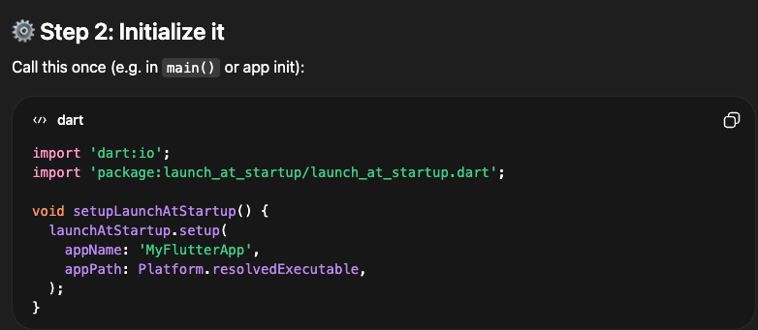
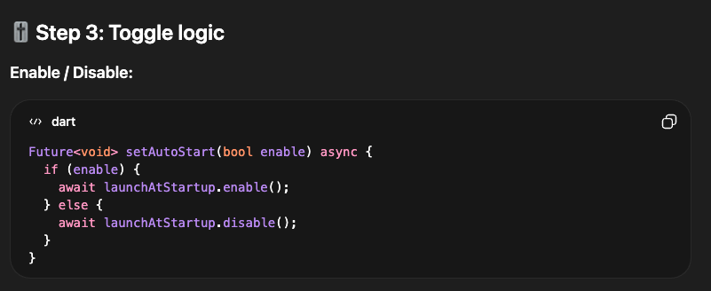
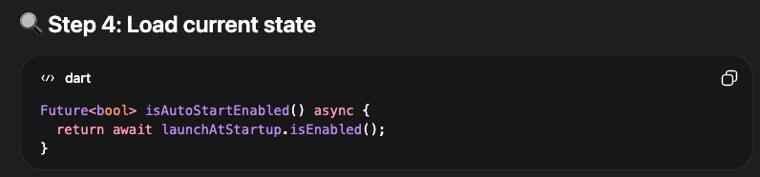
How to auto-launch an app when Windows starts
Use plugin
launch_at_startup
Link: https://pub.dev/packages/launch_at_startup

Slide 17
Scenario Actions
A: Regular Backup (pull)
B: Real-time Backup (push)
Scenario | Action
App starts, no gap (smart reconnect) | B → MAIN DB directly. No A needed.
App starts, gap exists | B → TEMP DB; schedule A for off-peak (or manual trigger)
Off-peak arrives / manual trigger | A fills [lastLocal→T_connect] → MAIN DB; flush TEMP → MAIN DB; switch B → MAIN DB
Connection drops briefly (< interval) | Reconnect → smart reconnect → B → MAIN DB
Connection drops for extended period | Reconnect → B → TEMP DB; schedule A for off-peak
User presses 'Run Backup Now' | A runs immediately → flush TEMP → switch B to MAIN DB
Gap-fill fails after 3 retries | Skip chunk, flag for next cycle, continue other DBs
During controller write time (:XX:00) | Stagger requests to :XX:30 (30s offset)
App crash during A execution | TEMP DB persisted on disk → resume on next start
In Summary — Sequential A→B with Temp DB
A and B write to DIFFERENT databases until A completes — strict chronological order.
Smart reconnect: if gap < interval, B writes to MAIN DB directly (no temp needed).
Off-peak default (midnight) with manual 'Run Backup Now' trigger.
Staggered timing: all requests at :XX:30, never at :XX:00. Avoids controller conflicts.
Temp DB = separate SQLite file (crash-safe, persisted on disk).

Slide 18
Regular Backup – Chunked Request
Constraints
Point Batching Required
Processing Order
Max request period: 7 days
Max data points per request: 256
Optime: 537 points → 3 batches of 256
Trend: 239 points → 1 batch (fits in 256)
1.History 2.Meter 3.PPD
4.Optime 5.Trend (smallest first)
Staggered Timing + Off-Peak
All requests offset 30-40s past interval marks
Trend: :00:30, :05:30, :10:30 ...
PPD/Optime/Meter: :00:30, :15:30 ...
Off-peak: default midnight (03:00)
Manual trigger: 'Run Backup Now' button

Slide 19
Edge Cases & Handling (1/2)
# | Edge Case | Risk | Handling
EC1 | App crash while B writes to TEMP | Partial write / unflushed TEMP | SQLite WAL ensures atomic writes. On restart: detect TEMP file → resume B to TEMP, schedule A.
EC2 | App crash during A (gap-fill) | Gap partially filled in MAIN DB | Track lastLocal per chunk. On restart: resume A from checkpoint. B stays on TEMP. Partial A never triggers flush.
EC3 | App crash during TEMP→MAIN flush | Duplicate or missing records | Wrap flush in single transaction (BEGIN→INSERT→COMMIT). Crash before COMMIT → nothing inserted → safe retry.
EC4 | App crash after flush, before cleanup | App thinks flush hasn't happened | Use flush_status flag (pending/in_progress/completed). On restart: if completed → delete TEMP, switch B to MAIN.
EC5 | Controller offline during A | A cannot complete, TEMP keeps growing | Retry chunk 3x → skip & flag for next cycle. B stays on TEMP. TEMP growth is bounded (small real-time data).
EC6 | App closed before off-peak | TEMP has full day of unflushed data | TEMP persists on disk. Next launch picks it up. Next off-peak: A fills gap → flush → resume. No data loss.

Slide 20
Edge Cases & Handling (2/2)
# | Edge Case | Risk | Handling
EC7 | Multiple connect/disconnect cycles | Multiple gaps, complex state | Append to same TEMP file. Track gap_ranges array. A fills ALL gaps at off-peak → flush entire TEMP.
EC8 | TEMP DB corrupted | Real-time data in TEMP lost | Discard TEMP. Extend gap to [lastLocal→now]. Re-pull from controller at next off-peak. No permanent loss.
EC9 | MAIN DB corrupted | Serious — all local data at risk | Periodic PRAGMA integrity_check. Recovery: FTP full backup + incremental A. Keep daily DB snapshots.
EC10 | Very long gap (weeks offline) | A takes hours, overlaps into peak | Time fence: pause A at 6am, resume next off-peak. B stays on TEMP throughout. Chunked + staggered.
EC11 | Smart reconnect misjudgment | Missed records not in TEMP | Use conservative margin (gap < interval - 30s). Missed data caught by next A cycle from controller.

Slide 21
State Persistence
These fields are stored in backup_metadata.json and must survive app crashes.
Field | Purpose
lastLocal (per DB type) | Last timestamp in MAIN DB. Updated after each A chunk and after flush.
T_connect | Timestamp when app last connected. Defines gap range.
backup_state | Enum: idle / realtime_temp / realtime_main. Tracks where B writes.
flush_status | Enum: pending / in_progress / completed. Tracks flush progress.
gap_ranges | JSON array of [start, end] pairs. Tracks unfilled gaps for A.
temp_db_path | Path to current TEMP DB file (if exists).

